Slide 1
Presentation on
PERIPHERAL DEVICES
Presented by : Sangeeta , Swati

Slide 2

INTRODUCTION
Peripheral devices, also known as peripheral, computer peripheral input/output device, any of various devices (including sensors) used for entering information and instructions into computer system for storage or processing and for delivering the processed data to a human operator or, in some cases a machine controlled by the computer.

Slide 3
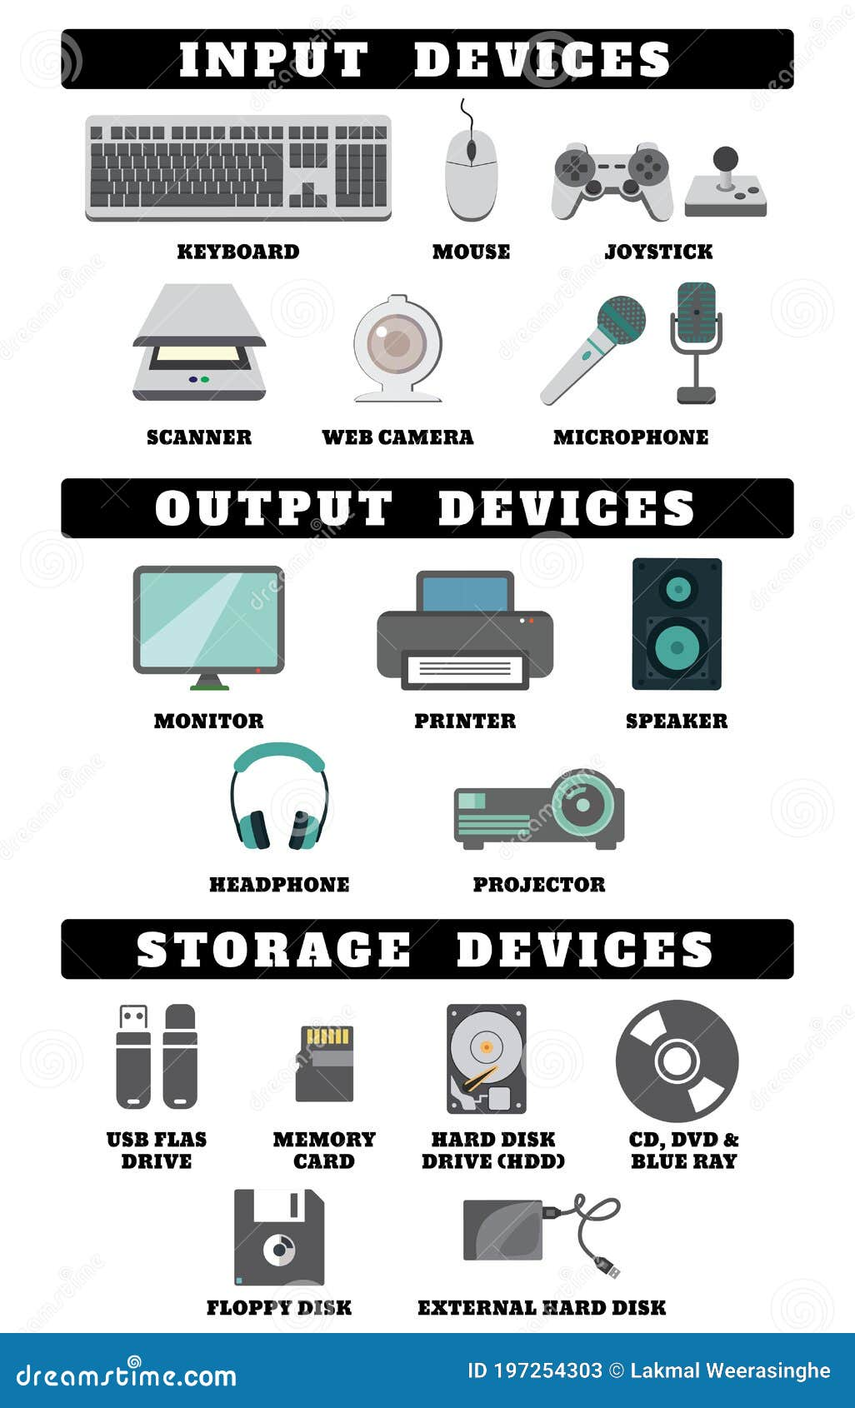
Identify computer peripherals
Peripheral devices are mainly divided into three parts :
INPUT DEVICE
OUTPUT DEVICE
STORAGE DEVICE

Slide 4
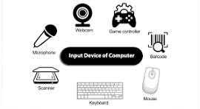
INPUT DEVICE
Input devices are the devices that are used for entering the data and instructions.
Keyboard
Mouse
Touch Panel

Slide 5
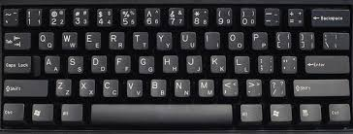
KEYBOARD
It is the most popular and primary input device for entering data and instructions. It is similar to keyboard of typewriter. It contains cursor control key and function keys.

Slide 6
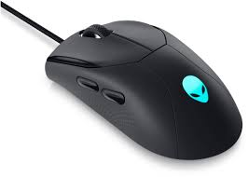
Mouse
The mouse has two or three buttons on its top for indicating the execution of the some operation. By pressing the button the user indicates his/her choice to the computer.
There are three kinds of clicks – left click, right click and double click, the mouse can be used to drag and drop object on the screen.

Slide 7
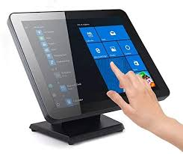
TOUCH PANEL
It allows selection by touch of a finger. It uses special type of monitor. We don’t need keyboard to feed input.

Slide 8
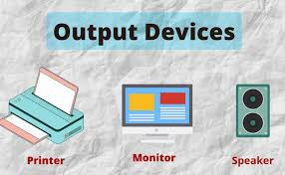
Output device
The output device display the result on screen after processing. The computer gives output through an output device such printer or a monitor.
Monitor
Printer
Speaker

Slide 9
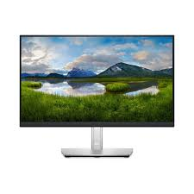
monitor
The monitor is like the television screen which display information and picture in bright letters. This is also called Visual Display Unit.

Slide 10
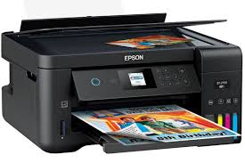
printer
A printer is a peripheral devices that produces a hard copy (physical printout) of digital documents, images, or graphic from a computer or other electronic device.

Slide 11
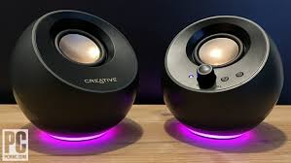
Speaker
A speaker is an audio output device that converts electrical signals into sound, allowing users to hear audio content such as music, or sound effects, speakers can very widely in type and design.

Slide 12
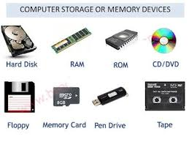
Storage device
Auxiliary storage devices are the devices mainly used for storage purposes. These are important as they help to save the data.
Primary memory
Secondary memory
Cache memory

Slide 13
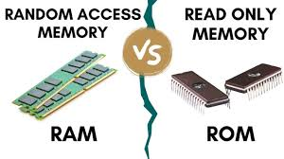
Primary memory
It is also a semiconductor memory which employs dynamic RAM’s. it stores data and instructions currently needed by CPU.
Types of primary memory
RAM ( Random access memory)
Read/Write memory of computer.
Volatile in nature.
Retains information as long as power supply is ON.
ROM ( Read only memory)
Read only.
Non- volatile memory
contents written at the time
of its IC fabrication.

Slide 14
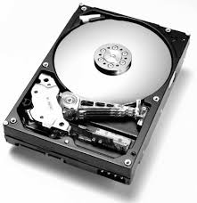
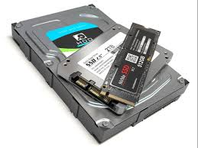
SECONDARY MEMORY
The information which is not being currently processed resides on the magnetic memory or secondary memory.
Main / Fixed memory
Hard disk
Each track is divided into a
number of fixed length
physical blocks called sectors.
sector is the smallest unit of
data of transfer.
Solid state disk
A solid-state drive is a type of solid storage device that uses integrated circuits to store data persistently.

Slide 15
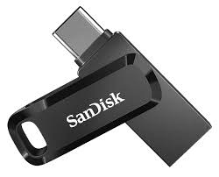
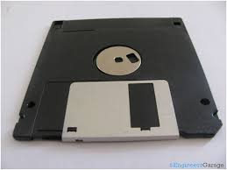
Secondary memory
Removable memory
Flash Drive
A Pen drive, also known as a USB flash drive, memory stick, or thumb drive, is a small, portable device that stores and transfers data.
Floppy Disk
A floppy disk is a removable storage medium used to store data on computer.
It is a thin, flexible
magnetic disk sealed in a square plastic carrier.

Slide 16
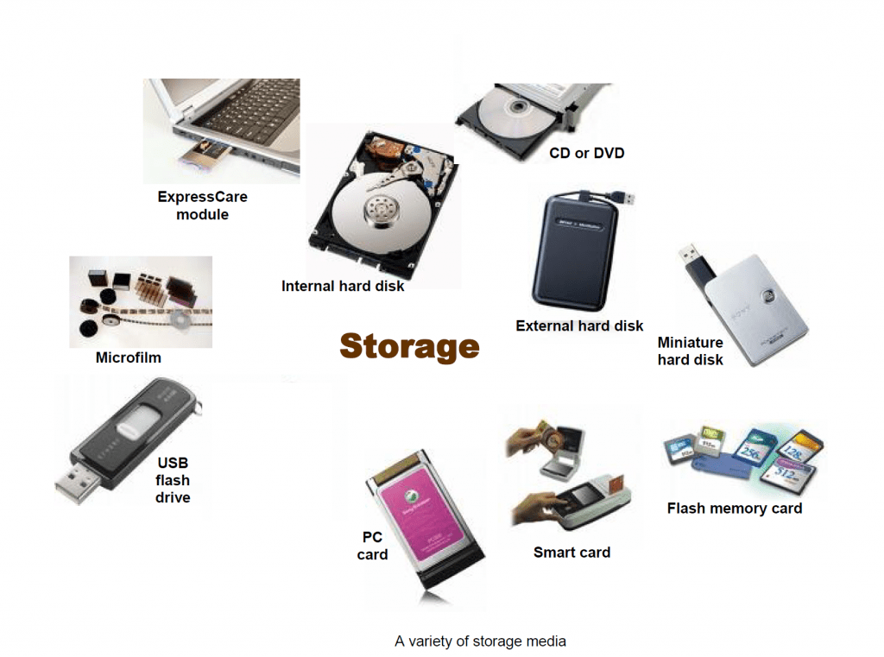
SOME MORE EXAMPLES OF REMOVABLE MEMORY
External hard drive
Memory cards
Optical disks
Zip disks/Floppy disks
Digital cameras
Smart phones
Compact disc
Magnetic
Blu-ray-disk
DVD

Slide 17
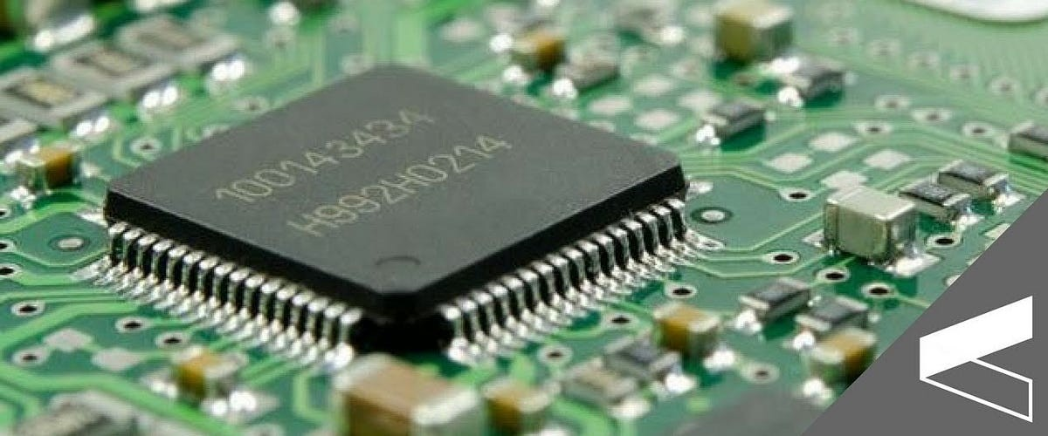
Cache memory
Cache memory is a chip-based computer component that make retrieving data form the computer’s memory more efficient.
It acts as a temporary storage area that the computer’s processor can retrieve data from easily. This temporary storage area, know as a cache, is more readily available to the processor than the computer’s main memory source, typically some form of dynamic random access memory (DRAM).
Cache memory is sometimes called CPU (Central processing unit) memory because it is typically integrated directly into the CPU chip or placed on a separate chip that has a separate bus interconnect with the CPU.

Slide 18

THE END……

